Slide 1
Towards rapid, reproducible and robust modeling

Slide 2
Towards rapid and reproducible and robust real-world decision support modeling
Do they even intersect???
Rapid
Reproducible
Robust

Slide 3
Outline
Opening remarks
Why is R³ so hard?
A path towards R³
The problem with robust
Razzle dazzle!

Slide 4
Open-source coding takes a village
PEST++
Dave Welter, John Doherty, Randy Hunt, Mike Fienen, Wes Kitlasten, Matt Knowling, Mike Towes
pyEMU
Mike Fienen, Wes Kitlasten, Matt Knowling, Brioch Hemmings, Ayman Alzraiee, Otis Rea
FloPy
Chris Langevin, Joe Hughes, Matt Knowling, Brioch Hemmings, Mike Towes, Mike Fienen, Andy Leaf, Scott Paulinski, Josh Larsen, Eric Morway, Jason Bellino

Slide 5
Context: the modeling workflow
Rapid: faster response to mgmt questions
risk horizons are getting shorter…
...more freq decision making
Reproducible: retrace steps from beginning to end
The scientific method
contentious models/settings
open source tools!
Robust: provide risk-conservative answers to mgmt questions
stochastics
high-dimensionality
avoid bias from model error

Slide 6
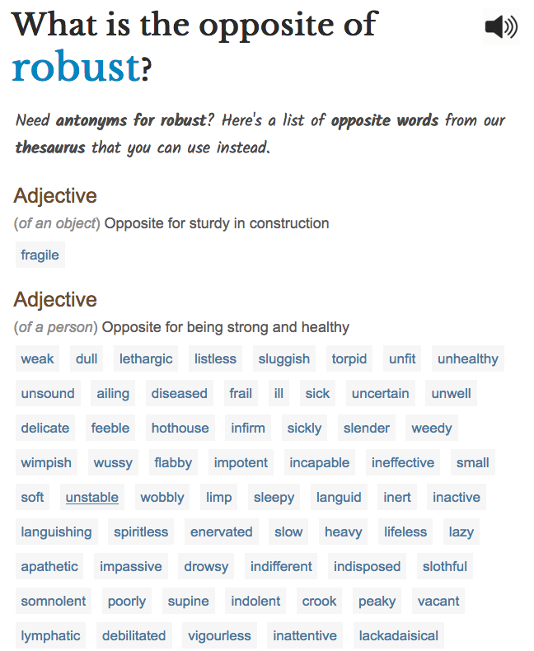
Currently (IMHO)...
Not rapid: takes too long, costs too much
Not reproducible: opaque process
Not robust: non-conservative risk
Rapid
Reproducible
Robust

Slide 7
Why is R³ so hard?

Slide 8
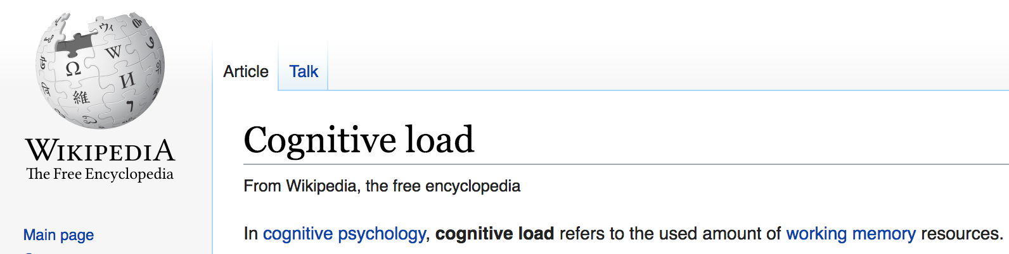

Slide 9
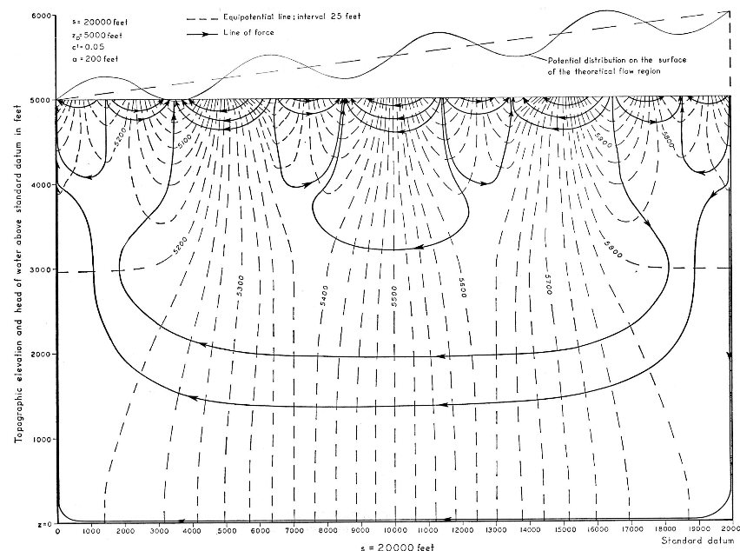
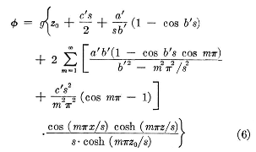
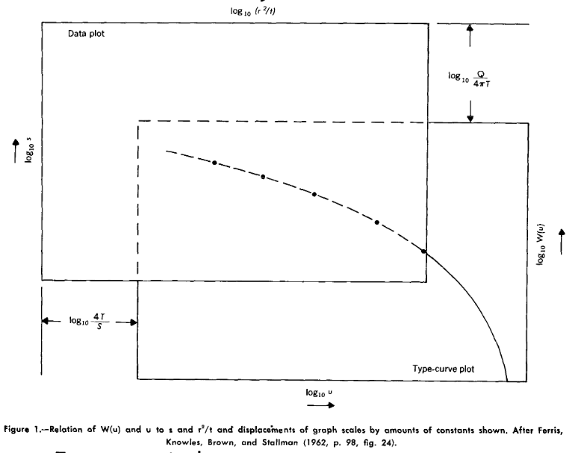
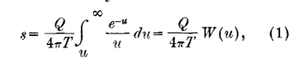
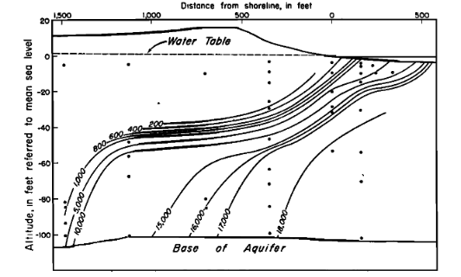
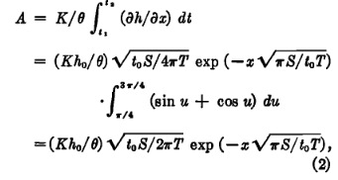
cognitive load in env simulation
Physics (hydraulics/hydrology/hydrogeology)
Math (closed-form/analytical techniques)

Slide 10
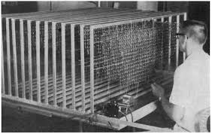
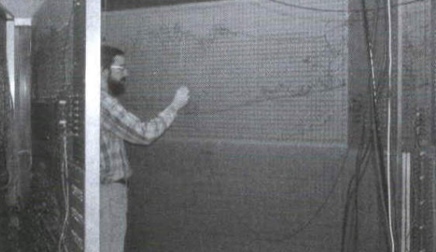
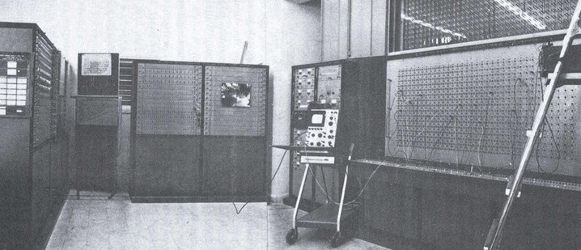
cognitive load in env simulation
Physics (hydraulics/hydrology/hydrogeology)
Math (closed-form/analytical techniques)
Electrical engineering

Slide 11
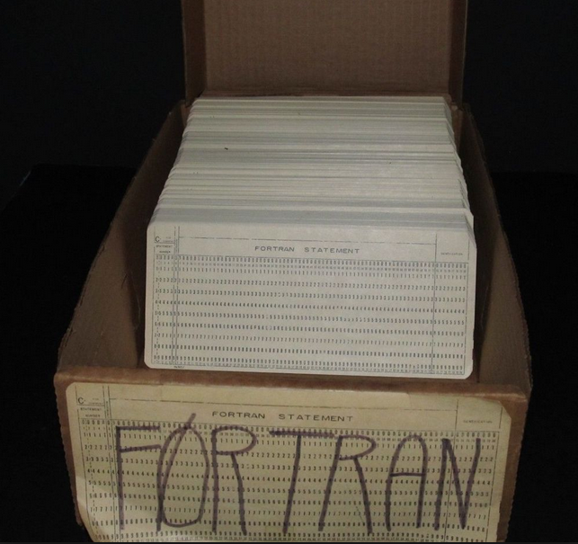
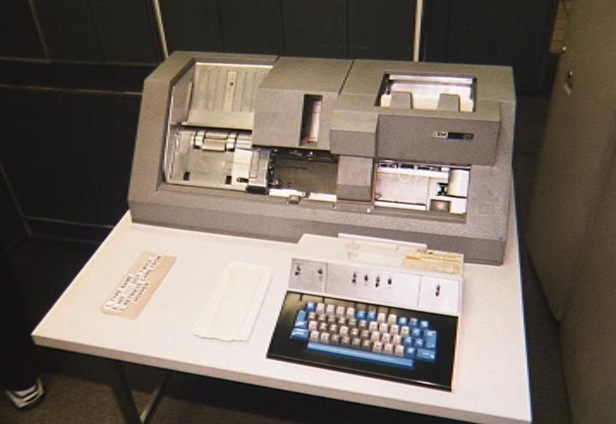
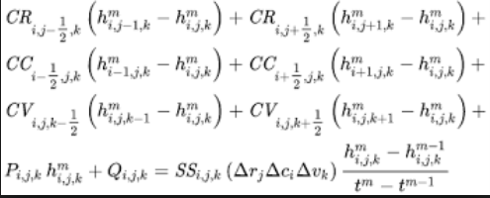
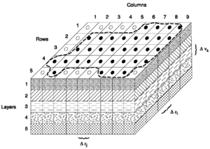
cognitive load in env simulation
Physics (hydraulics/hydrology/hydrogeology)
Math (closed-form/analytical techniques)
Electrical engineering
Programming (and punch card patience!)
Math (linear algebra)

Slide 12
The advent of decision support modeling
Not just “learning about the system”
“predicting” instead of “explaining”
Intense pressure on water resources
Increasing data/observations
The model as a repository of knowledge
Data assimilation to get data into the model
Hypothesis testing/stochastic scenarios to get data out of the model
Shmueli G. (2010) To explain or to predict?. Statistical science

Slide 13
cognitive load in env simulation
Physics (hydraulics/hydrology/hydrogeology)
Math (closed-form/analytical techniques)
Electrical engineering
Programming (and punch card patience!)
Math (linear algebra)

Slide 14
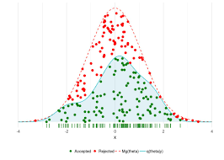
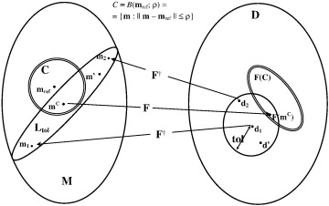
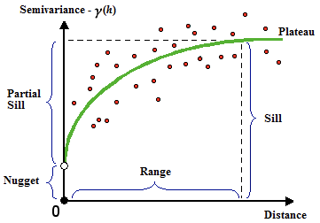
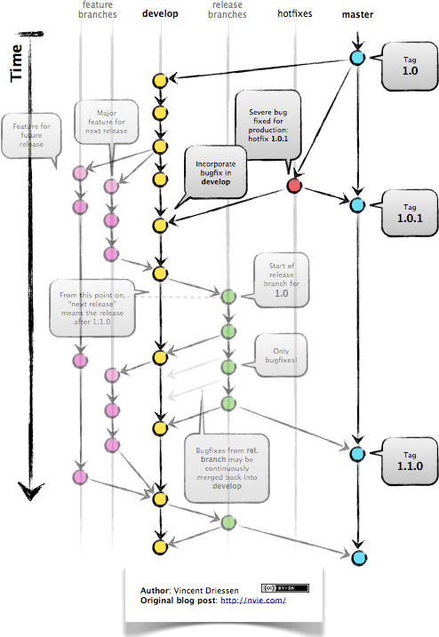

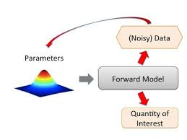
cognitive load in env simulation
Physics (hydraulics/hydrology/hydrogeology)
Math (closed-form/analytical techniques)
Electrical engineering
Programming (and punch card patience!)
Math (linear algebra)
High-dimensional inverse problem theory
statistics/uncertainty analysis/stochastics/etc

Slide 15

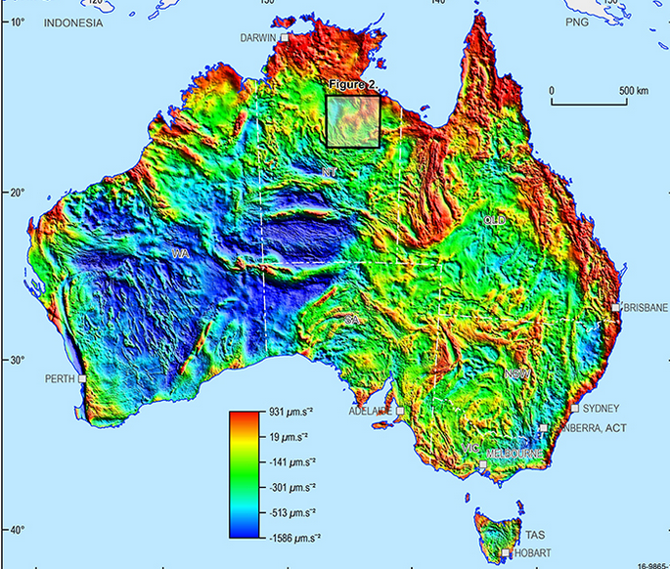
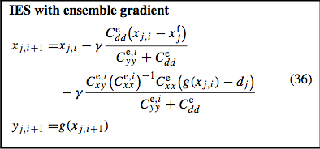
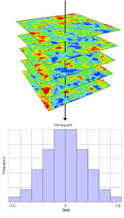

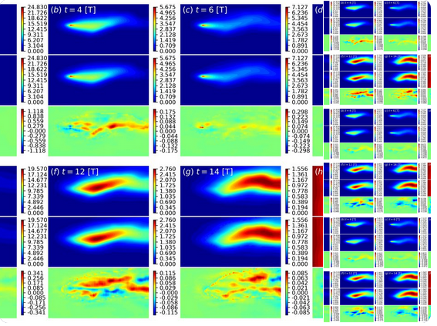

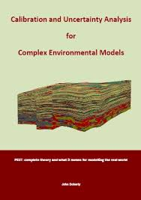
cognitive load in env simulation
Physics (hydraulics/hydrology/hydrogeology)
Math (closed-form/analytical techniques)
Electrical engineering
Programming (and punch card patience!)
Math (linear algebra)
High-dimensional inverse problem theory
statistics/uncertainty analysis/stochastics/etc
Data mgmt/GIS/geostatistics/etc

Slide 16
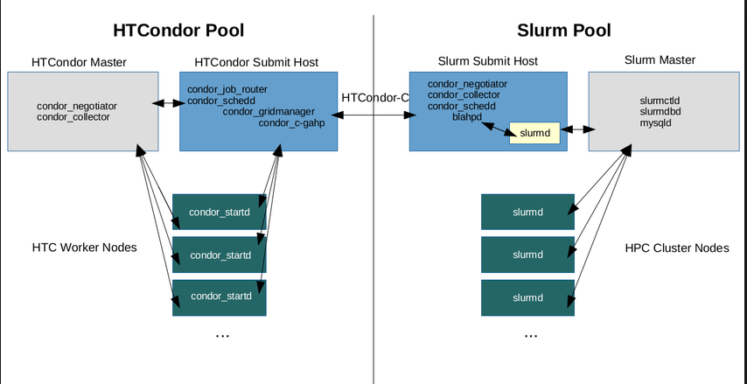
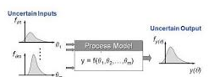
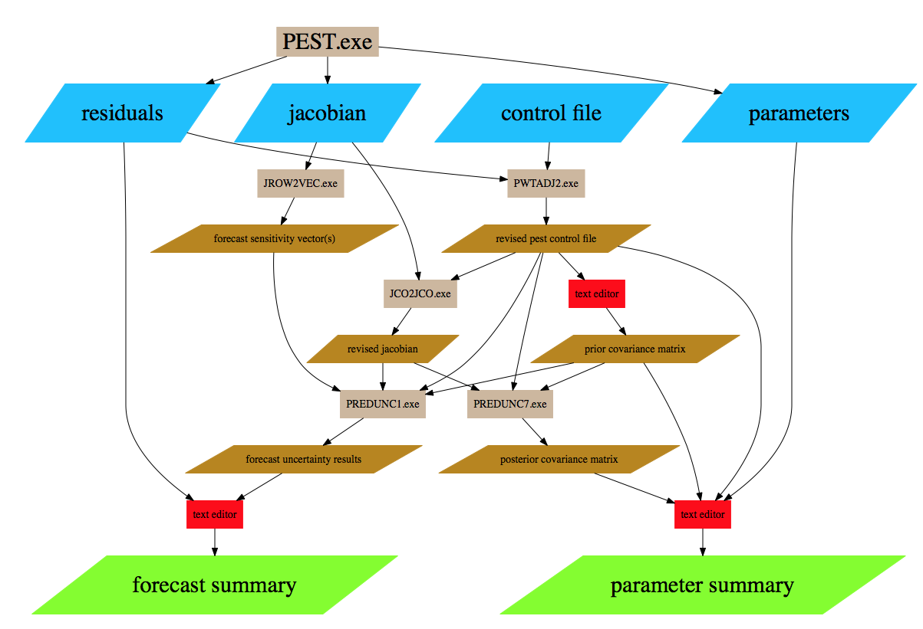
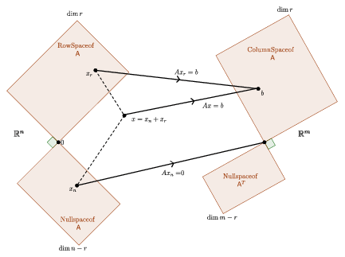
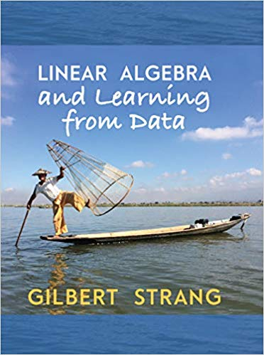

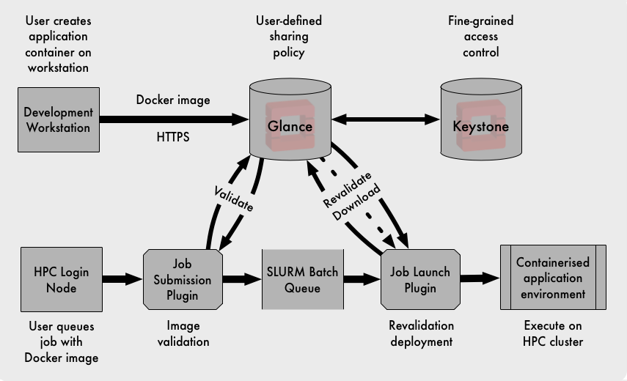
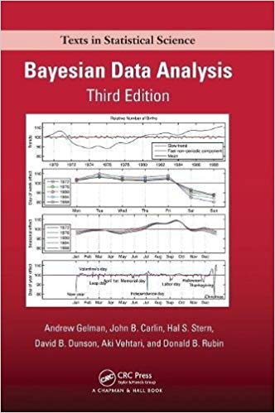
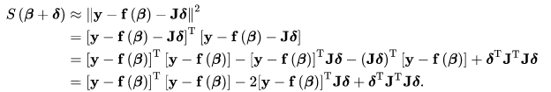
cognitive load in env simulation
Physics (hydraulics/hydrology/hydrogeology)
Math (closed-form/analytical techniques)
Electrical engineering
Programming (and punch card patience!)
Math (linear algebra)
High-dimensional inverse problem theory
statistics/uncertainty analysis/stochastics/etc
Data mgmt/GIS/geostatistics/etc
HPC/HTC/mgmt optimization/global methods/etc
System dynamics/ABM/econ/etc
Comp sci/etc

Slide 17
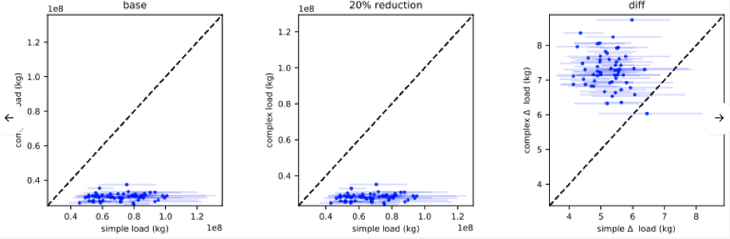
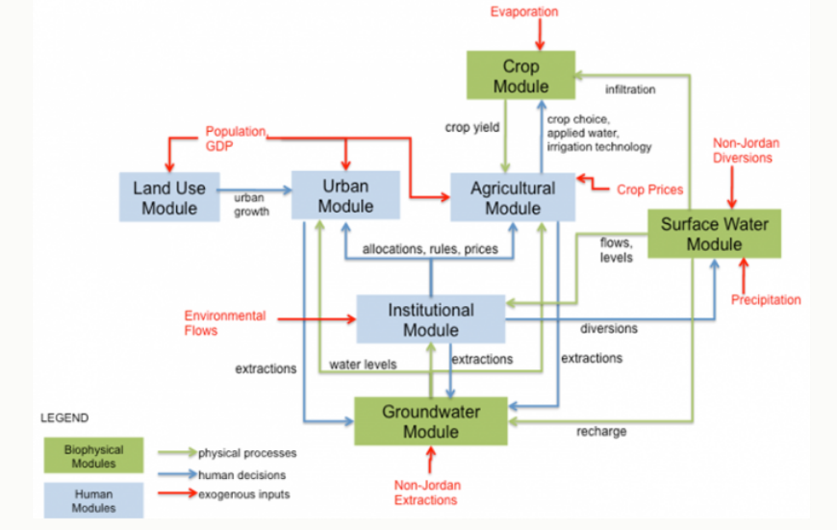
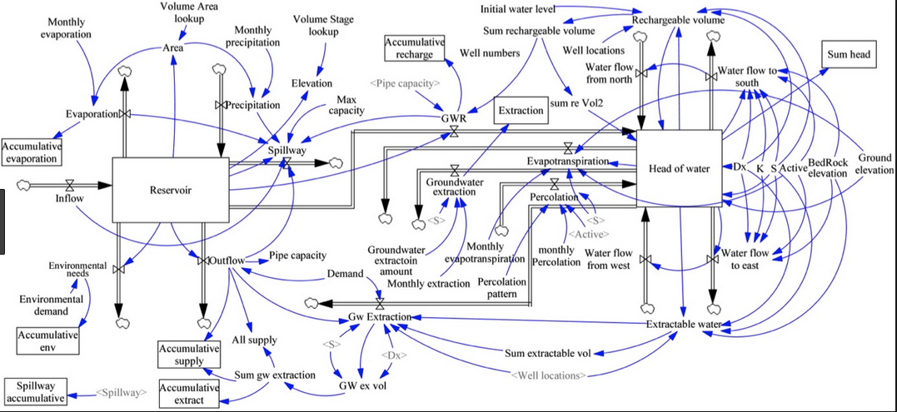
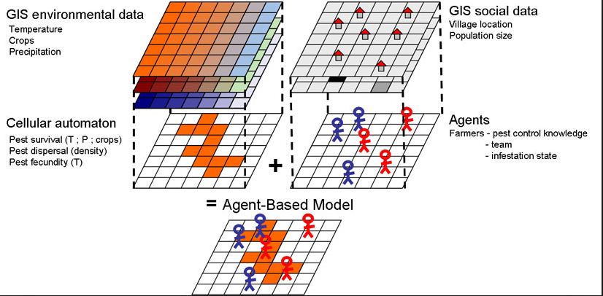
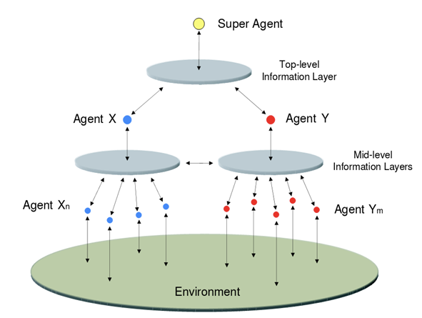
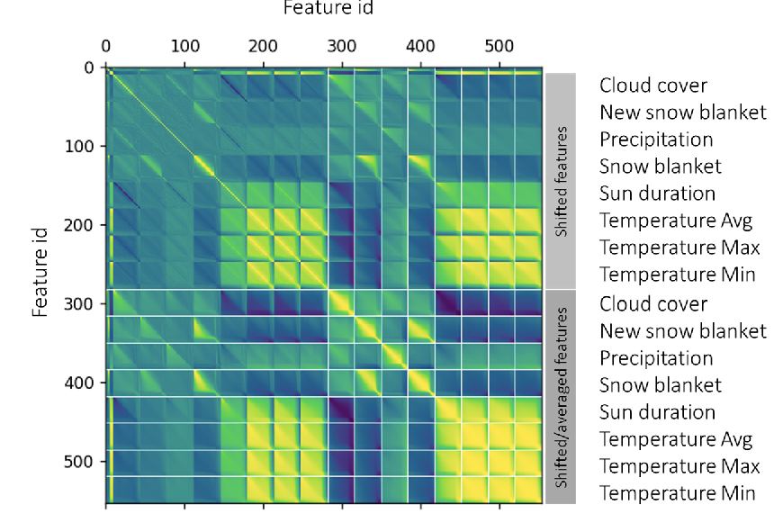
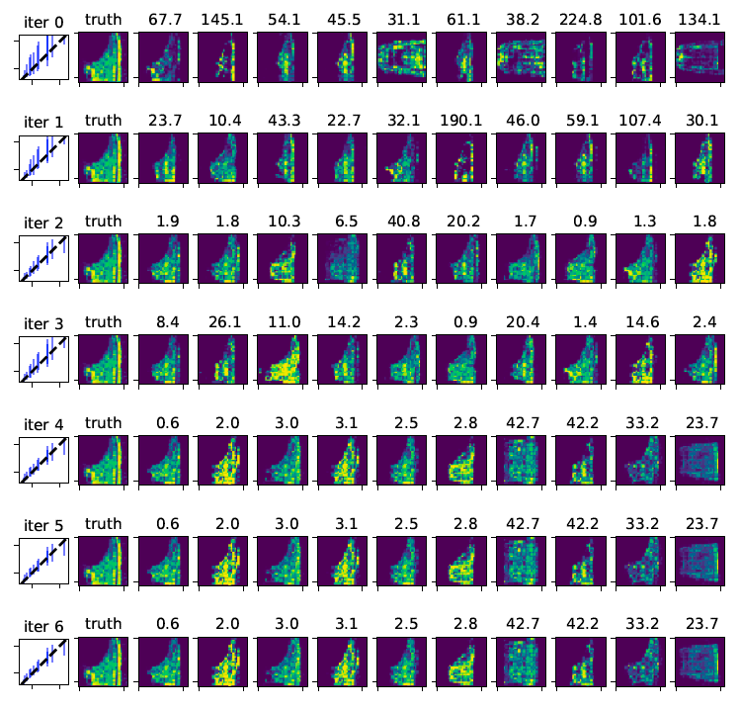
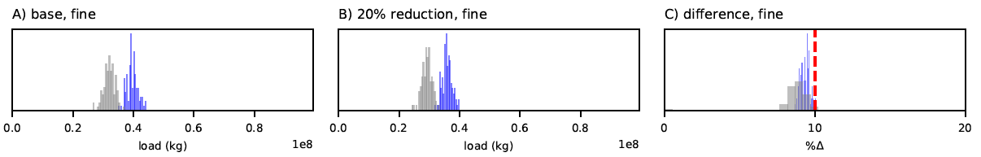
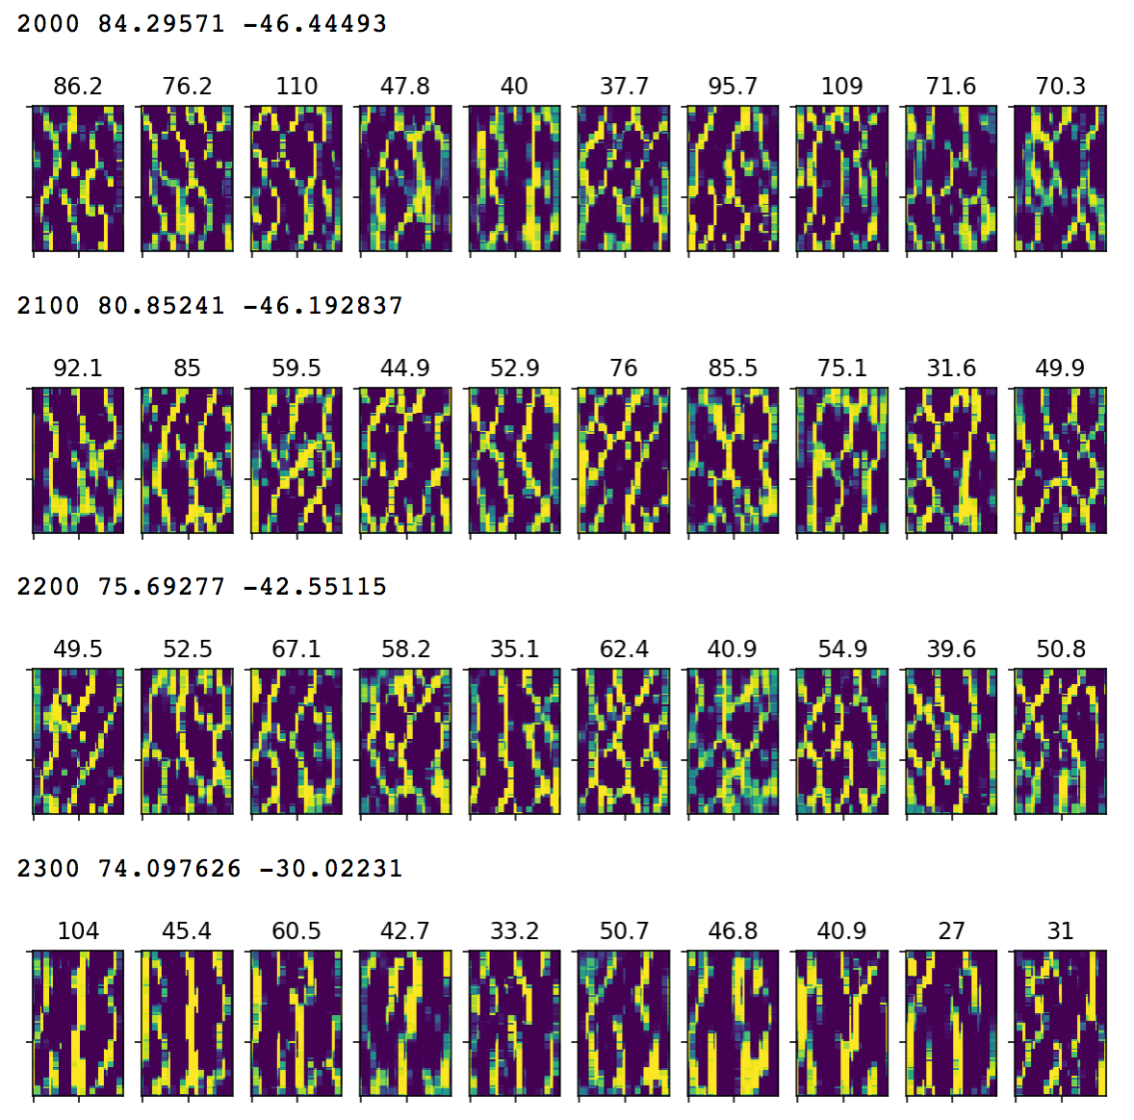
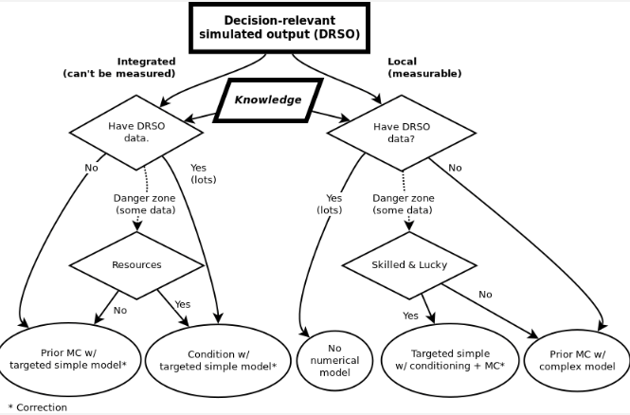
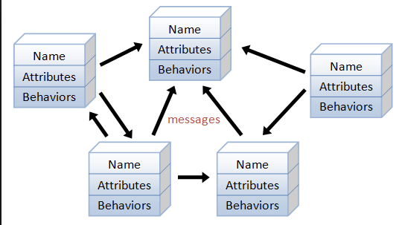
Physics (hydraulics/hydrology/hydrogeology)
Math (closed-form/analytical techniques)
Electrical engineering
Programming (and punch card patience!)
Math (linear algebra)
High-dimensional inverse problem theory
statistics/uncertainty analysis/stochastics/etc
Data mgmt/GIS/geostatistics/etc
HPC/mgmt optimization/global methods/etc
System dynamics/ABM/econ/etc
Comp sci/etc

Slide 18

Physics (hydraulics/hydrology/hydrogeology)
Math (closed-form/analytical techniques)
Electrical engineering
Programming (and punch card patience!)
Math (linear algebra)
High-dimensional inverse problem theory
statistics/uncertainty analysis/stochastics/etc
Data mgmt/GIS/geostatistics/etc
HPC/mgmt optimization/global methods/etc
System dynamics/ABM/econ/etc
Comp sci/etc

Slide 19
The modeling workflow and opportunities for hardship

Slide 20
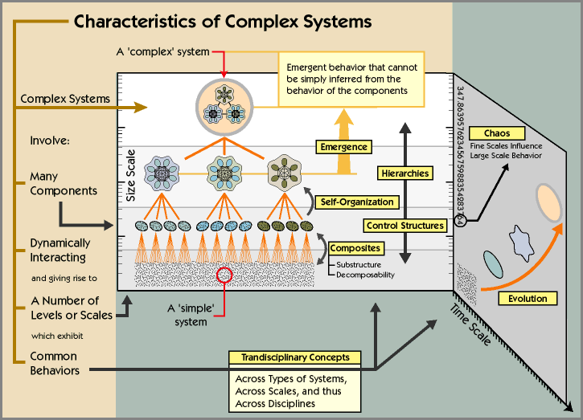
Modeling workflows in a systems analysis context
Env simulation workflows are “complex”
Many interdependencies
Many assumptions/decisions
“Fine scales influence large scales”

Slide 21
Modeling workflows in a systems analysis context
(distributions of) quantities of interest
Env simulation workflows are “complex”
Many interdependencies
Many assumptions/decisions
“Fine scales influence large scales”
Data assimilation
engine
forward
model
Processes and packages
Pre- and post- utils, Prior distro, obj func
model flags, solver tols, etc
Data assimilation flags/options, parameters, observations

Slide 22
“what can go wrong, will go wrong”
The scientific method’s central motivation is the ubiquity of error—the awareness that mistakes and self-delusion can creep in absolutely anywhere and that the scientist’s effort is primarily expended in recognizing and rooting out error.
Donoho et al. 2008. Reproducible research in computational harmonic analysis

Slide 23
Opportunities for hardship - a generic workflow
“what can go wrong, will go wrong”
Gathering datasets
Data processing
Model input dataset construction
Data Assimilation/history matching
Scenario analyses/hypothesis testing/follow-on
Post-processing/reporting

Slide 24

Opportunities for hardship - X factors
“Can you run a scenario to evaluate X?” (and another one, and another one)
“Those data for X had the wrong Y”
“We just found more data for X”
“I thought X was Y instead of Z”
How long does it take to “recover” from X? IMO - days to weeks ($$$)

Slide 25
Opportunities for hardship - X factors
Def not rapid...and reproducible is not looking good...
“Can you run a scenario to evaluate X?” (and another one, and another one)
“Those data for X had the wrong Y”
“We just found more data for X”
“I thought X was Y instead of Z”
How long does it take to “recover” from X? IME - days to weeks ($$$)

Slide 26
A path “towards” R³

Slide 27

Software development and “mundane details”

Slide 28
A (scripted) path “towards” R³
Injecting software development approaches
Stepwise,incremental complexity with testing
Version control
Use of scripting-driven workflows
Fail faster, “recover” quickly
don't re-make mistakes
No longer need to actively remember all the steps...
Notes:
There are a lot of parallel between software development and env simulation workflows

Slide 29

A (scripted) path “towards” R³
Cognitive load can be devoted to higher-level concepts and issues
(science!)

Slide 30

GIT (reproducible)
(very) popular and free version control system
Complete record of all file changes
As issues are rectified, they are (self-)documented
Efficiently distribute “cognitive load”
The repo becomes the “modeller’s log”

Slide 31
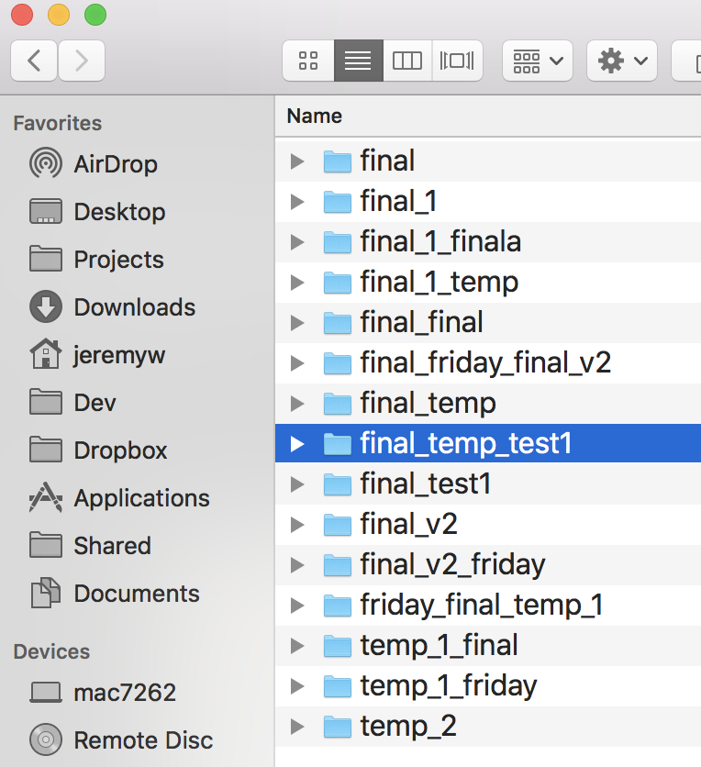
not reproducible

Slide 32
GIT (reproducible)

Slide 33
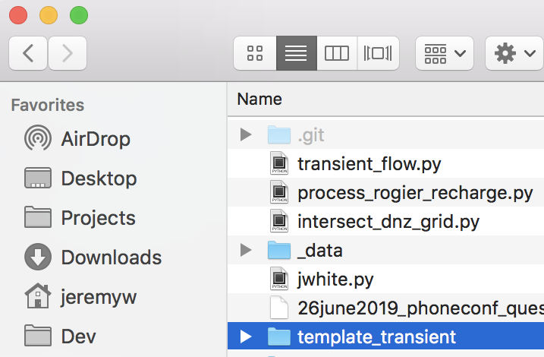
GIT (reproducible)

Slide 34
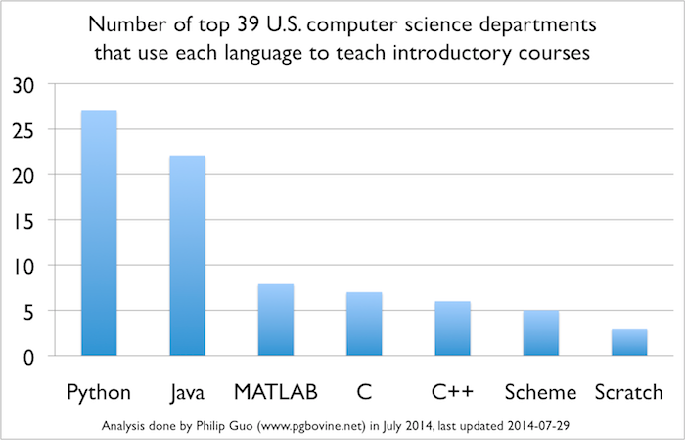
Python (rapid* and reproducible)
* - can be...

Slide 35
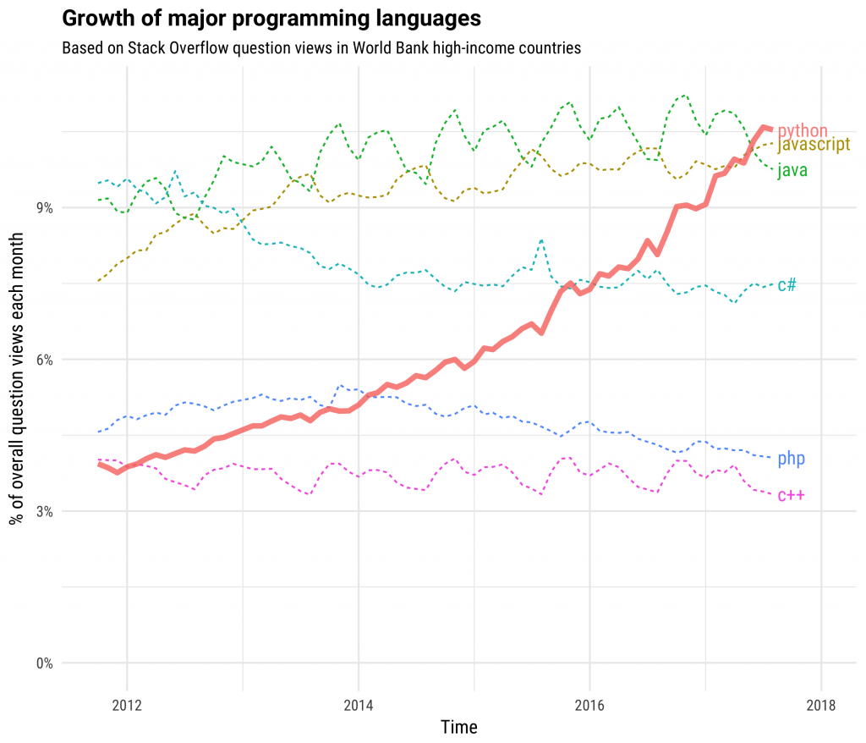
Python (rapid* and reproducible)
* - can be...

Slide 36
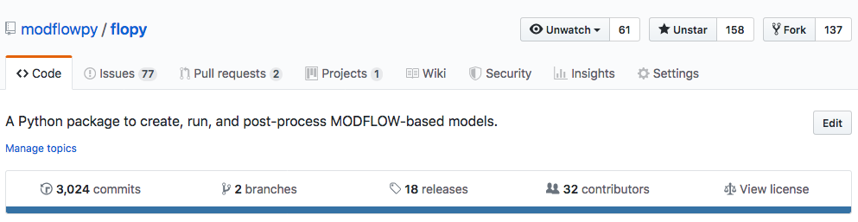
flopy
https://github.com/modflowpy/flopy
programmatic forward model setup and processing
Lots of support utils to deal with “special” MODFLOW options
Support for NetCDF/shapefiles/VTK/etc
Surprisingly popular...
Bakker and others(2016). Scripting MODFLOW model development using Python and FloPy. Groundwater

Slide 37
The problem with robust

Slide 38
The problem with robust
In a perfect, deterministic world, reproducible and rapid are “easy”
BUT! Model error and stochastics (ensembles)
Clever but high-dimensional parameterization
processed/derived observations and clever weighting
etc
Rapid
Living dangerously
Git-python-flopy
Reproducible
Robust
Crazy slow

Slide 39
The problem with robust
Need tools and approaches to facilitate
Rapid and Reproducible data assimilation and
scenario eval / hypothesis testing

Slide 40

PEST++
https://github.com/usgs/pestpp
C++
ah yeah!
All tools are fully compatible with PEST
All tools have a baked-in, fault-tolerant parallel run mgmt
PESTPP-GLM - repro of PEST(_HP) with some auto uncertainty components
PESTPP-OPT - Mgmt optimization under uncertainty (SLP)
PESTPP-SEN - Global sensitivity analysis (Morris, Sobol )
PESTPP-IES - Iterative, localized ensemble smoother

Slide 41
PEST++
In development:
PESTPP-MOU
Constrained multi-objective (genetic) optimization under uncertainty
SPEA-II, NSGA-II, DiffEvol
Zak Stanko (USGS)
PESTPP-SQP -
Constrained (ensemble) sequential quadratic programming under uncertainty
Matt Knowling (GNS)
PESTPP-EKF -
Ensemble Kalman filter (and variants)
Ayman Alzeriee (USGS)

Slide 42

PESTPP-IES
Ensemble-space upgrades
Parallel and multi-threaded
Fully-localized solve
Rapid: computationally efficient
Robust: unavoidable uncertainty
White (2018). A model-independent iterative ensemble smoother for history matching and uncertainty quantification in very high dimensions.

Slide 43
Why PEST(++)?
“Why MODFLOW or FEFLOW?”
Focused on real-world-scale decision-support modeling
Critical part of Reproducible
Standard and consistent model interface
In decision support, data assimilation tools are just as important as the numerical model

Slide 44

pyEMU
https://github.com/jtwhite79/pyemu
FOSM/Monte Carlo/Ensembles/etc
programmatic PEST(++) setup and processing
Prototyping env - “in the works”
White and others (2016). A python framework for environmental model uncertainty analysis

Slide 45

flopy + pyEMU: From go to woah
Programmatically construct PEST interface around any MODFLOW model
Mixtures of nested spatial parameters
Mixtures of temporal parameters
YUGE numbers of pars and obs
Forward run script
Define priors
Geostatistical covariance and draws
Earlier and more frequent data assimilation!

Slide 46

flopy + pyEMU: From go to woah

Slide 47
automating a generic workflow
Gathering datasets: python, git
Data processing (GIS, etc): python (shapely, qgis, etc), git
Model input dataset construction: python, flopy, pyemu, git
Data Assimilation: forward model, PEST(++), python, flopy, pyemu, git
Scenario analyses/hypothesis testing: forward model, PEST(++), python, flopy, pyemu, git
post-processing/reporting: python, flopy, pyemu, git

Slide 48
No free lunch…but #dividends
There is an upfront (capital) investment
“Upskilling”, learning curve issues
There is an on-going (maintenance) cost
Some simple tasks won’t be as simple
In my experience, the return on the investment is can not be overstated
Significantly less desperation

Slide 49
No free lunch... but #dividends
There is an upfront (capital) investment
“Upskilling”, learning curve issues
There is an on-going (maintenance) cost
Some simple tasks won’t be as simple
In my experience, the return on the investment is can not be overstated
Significantly less desperation

Slide 50

Education
https://github.com/mnfienen-usgs/gw1876
Worked examples
Low-level (granular) and high-level topics
Confined to modflow-2005
Simple synthetic model

Slide 51
Razzle Dazzle!

Slide 52
(known) workflow applications
Hauraki Plains, NZ
Edwards Aquifer,USA
Ruamahanga (north and south), NZ
Mississippi Alluvial Plain, USA
Coastal Lowlands, USA
Central Sands, USA
rOpen, DK
Carson River, USA
Heretaunga Plains, NZ
Wellington Harbor, NZ
Heaps of synthetics!

Slide 53

Hauraki Plains, NZ
Purpose: regional-scale, policy-level land-use changes
MFNWT + MT3D-USGS (Tr + N)
7 layers, transient, blah,blah,blah
170K parameters
Grid scale,stress-period scale
5k GW level, 5k SW flow
100 realizations, 3 iterations
400ish runs

Slide 54


Traditional obsessions...

Slide 55

More meaningful outputs:

Slide 56

More meaningful outputs:

Slide 57

The repo...
Started on day 1
Over 180 commits
4 contributors
A complete record

Slide 58
The repo...

Slide 59

The repo...

Slide 60

The repo...

Slide 61

The repo...

Slide 62

#dividends
White and others (2019). Consequences of groundwater-model vertical discretization in risk-based decision making

Slide 63

#dividends
Knowling and others (under revision). On the assimilation of environmental tracer observations for model-based decision support

Slide 64

#dividends
Knowling and others (2019). Role of model parameterization in risk-based decision support: An empirical exploration

Slide 65


#dividends
White and others (under revision finally!). A non-intrusive approach for efficient stochastic emulation and optimization of model-based nitrate-loading management decision supportsupport

Slide 66

Edwards Aquifer, USA
Purpose: evaluate uncertainty
Existing MF2005
“Other people’s models”
1 layers, transient, blah,blah,blah
1 sim for history-matching
1 sim for scenario
330K parameters
Multi-scale spatial, stress-period scale
Heaps of state observations
300ish runs

Slide 67

Edwards Aquifer, USA
History-matching results
Pretty good fit to observed states!
the four locations of interest

Slide 68

Edwards Aquifer, USA
Hindcast scenario results
Pretty good fit to observed states!
These obs were not history matched!
the four locations of interest

Slide 69

Edwards Aquifer, USA

Slide 70

Edwards Aquifer, USA

Slide 71

(under review)
Edwards Aquifer, USA
Trying to get the message out about reproducibility thru scripting
https://github.com/jtwhite79/worked_example

Slide 72
Closing remarks
R³ is very hard to achieve
Its only gonna get harder...
The importance of R³ is growing (as it should)
Software dev and scripting approaches offers some hope!
No free lunch...but #dividends
This is not a solved problem…”towards” R³

Slide 73
Questions?
Rapid
Reproducible
Robust

